Slide 1
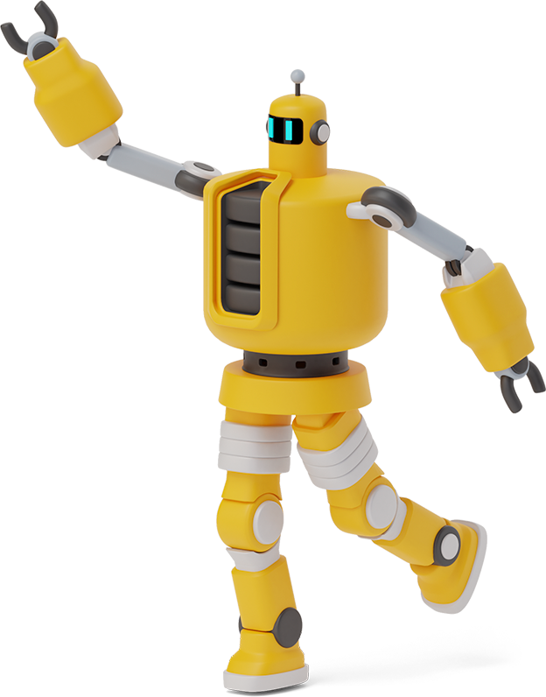
System level simulation of Multi-robot soccer game

Slide 2

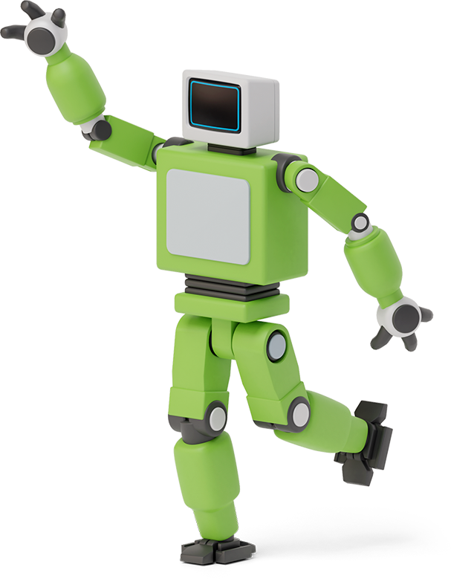

introduction
We will simulate a simple multi-robot soccer game which is a simple soccer game played by robots.
Each team has three kinds of players namely goalkeeper, attacker and defender.

Slide 3

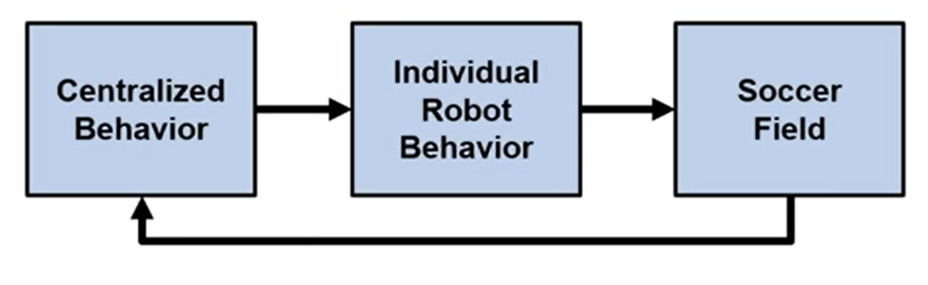
System model

Slide 4
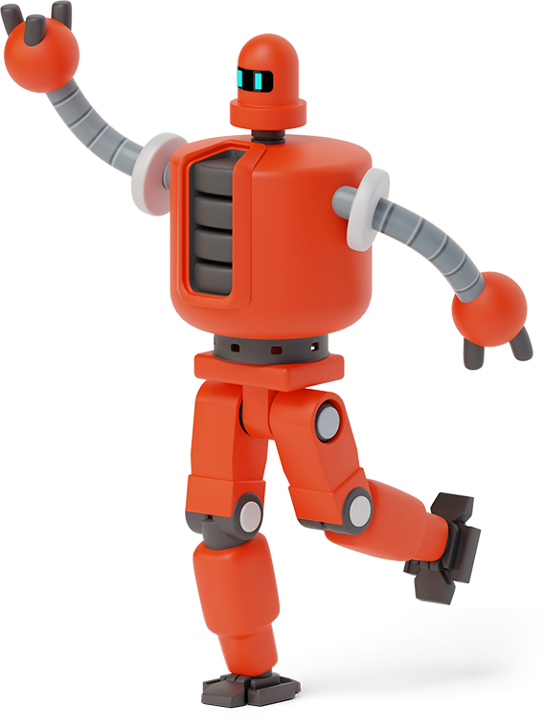
Soccer field
1
This is the arena in which the game takes place.
This simulation represents the physical part which will be replaced in the real world.

Slide 5
Individual robot behaviour
2
Each individual robot receives the information from sensors and the behaviour information depending on their roles in the game.
The same logic is represented for all the robots.

Slide 6
Centralized behaviour
3
A controller PC is connected from which all the information is sent to the robots.
It acts as the communication tool with the robots.
It is the controller PC which measures the locations of the robots, ball and sets the state of the game.

Slide 7
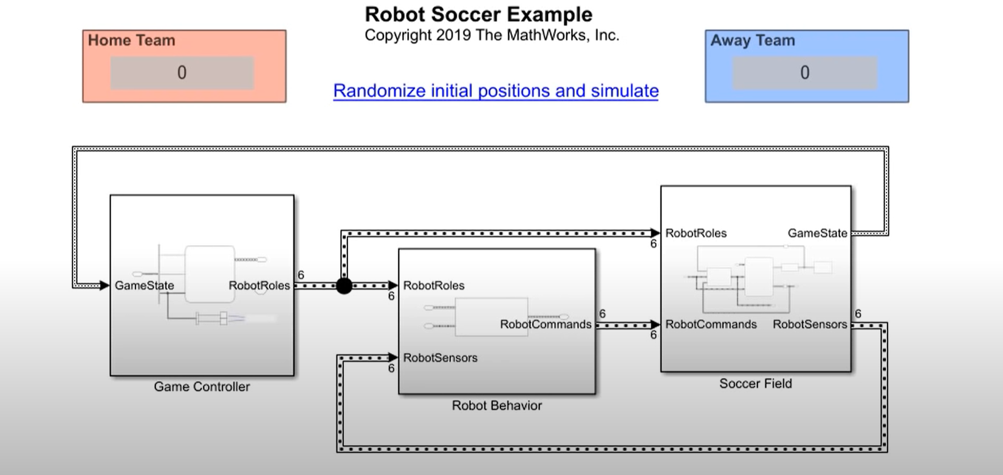
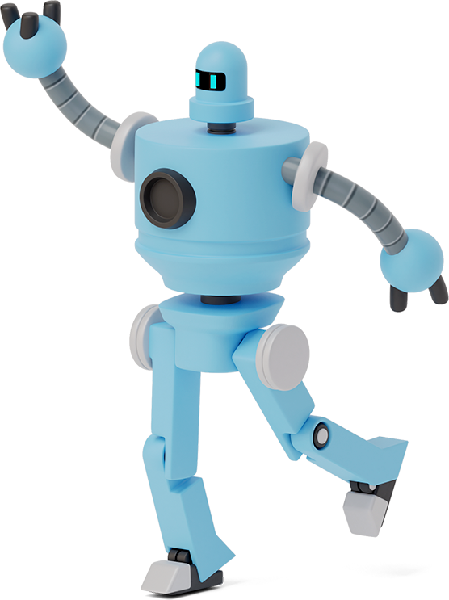
Simulink model

Slide 8
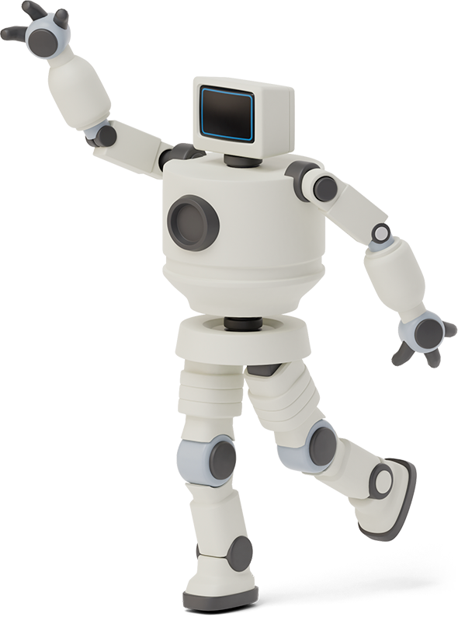

Concept: hybrid dynamic system
State flow is used in designing the hybrid dynamic system, which means one can switch from a dynamic system of equations to something purely algebraic.
Here, the Position of the ball is attached to the position of the robot holding it, so no dynamics is primarily involved for the ball.

Slide 9
Concept: hybrid dynamic system
When no player is holding the ball it is known as the free state or the Simulink state becomes a dynamic system. It will be first-order damped system in velocity because the velocity changes when the ball is moving in the free state as there is a damping quotient in the velocity.

Slide 10
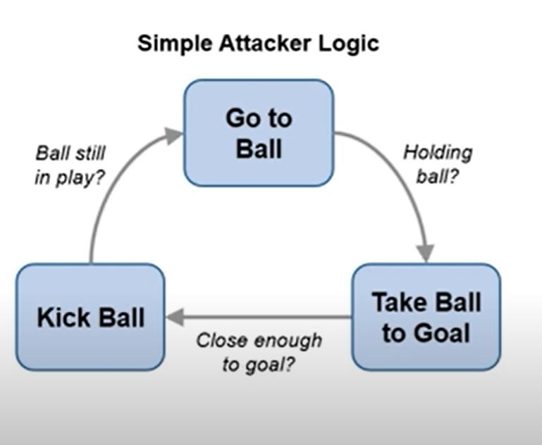
State flow and logic
Go to ball
Take ball to goal
Kick ball

Slide 11
Working process
Firstly, we will design the soccer field by giving the required dimensions. The required coordinates for the goal post were also given.
The initial positions of the players will be randomly generated. We will be giving the velocities for the players, the velocities with which they will be running in the field and also the angles in which the ball will change based on the role of player.

Slide 12
Working process
We will detect the ball whether it's in the hands of the players or on the free path.
The velocity of the ball is set and we will also give the damping quotient for the velocity of the ball.
The ball is released from the middle of the field, and both teams will fight to score the goals which will result in winning the team with more goals in a specific amount of time.

Slide 13
Results and conclusions
From the above-performed simulation, with the help of matlab and simulink we can get a simulation of team winning the game by scoring more goals in the given time.
This simulation can be used to perform a real soccer game between the robots in the arena.

Slide 14
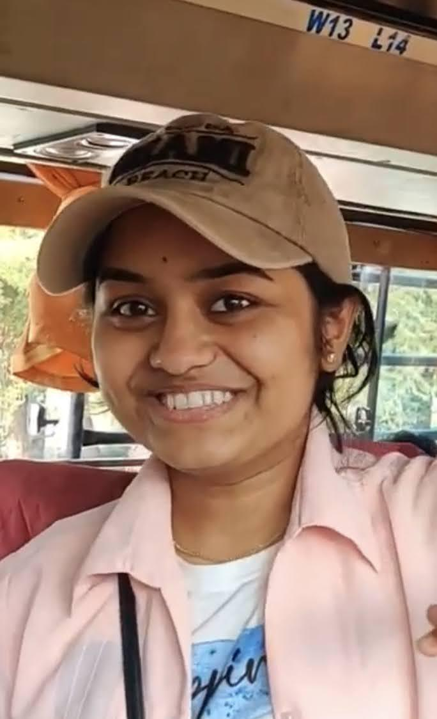

Thank you!
I am Sri Shakunthala yerneni
EE19B044

